Slide 1
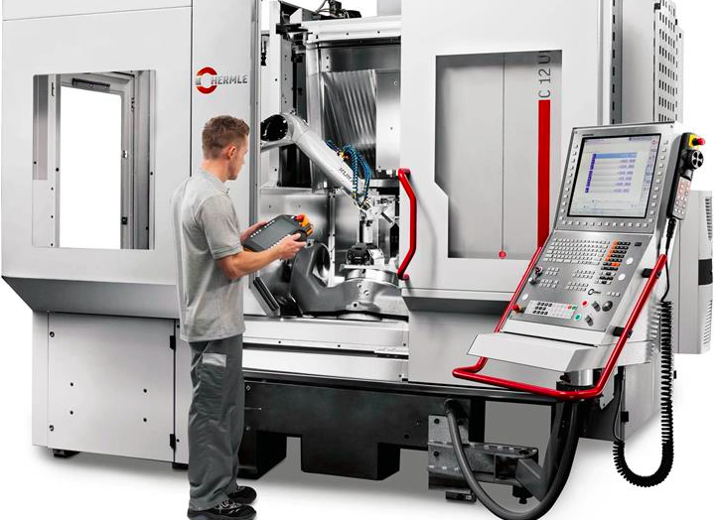
CHECK OUT OUR NEW WEBSITE: machinesandmethods.com
for a wide range of products offering solutions to your manufacturing needs for 2016 and beyond.
THE CUTTING EDGE Newsletter March 2016
Website Visit our Competencies area and put us to the challenge of finding
a better way
to make your parts!!.
Website Events & Newsletter section shows we are vitally involved in bringing the latest technologies to the NW.
Runoffs this Quarter:
Fermat Prague
43’ Travelling Column HMB w Head Changer
Chiron Tuttlingen
6m Bed Mill
Fryer New York
Two 5 Axis Mills
Thanks to all for a good first Quarter!
Install’s
this Quarter
HERMLE 5-Axis with TEN pallets
AccueteX Wire EDM
You Ji VTL
Mitsui Hi Tec Surface Grinders
Automation
Material Handling
Pallet Systems
Robotic Loading
Automatic Deburr
Turnkey
Automatic Vises & Fixtures
Just give us a call or email your request and we will provide you with a good solution.
Don’t Miss our SME Tech Talk See Page 2 Meet and Eat Pizza
Cell 425 444 1656 tony@machinesandmethods.com
425 681 8280 arif@machinesandmethods.com
503 544 9502 james@machinesandmethods.com
Office 425 746 1656 marlene@machinesandmethods.com
‘when you need a better way!’
Page 1 of 2

Slide 2
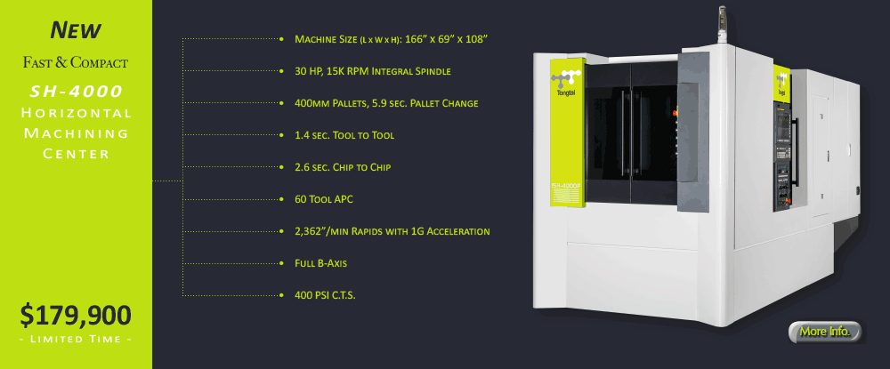
SME Event Seattle March 17th
Thursday 6pm
Zero Point Tooling
Network and Tech Talk
Hosted by Doug Hemenway (SCHUNK)
Learn how, despite the incredible advances in manufacturing technology over the years, one of the most fundamental components, clamping technology, has been stagnant and slow to progress. Discover how improving clamping technology can lead to: improved efficiency in the manufacturing process, better reliability with more precise clamping, and increased flexibility with standardized & automated change-overs.
Razzis Pizzeria 8523 Greenwood Ave N, Seattle, Cost: Pizza & soft drinks included $15 Program: 6:00-6:30 Social Hour 6:30-7:30 Tech Talk: Zero Point Tooling
Contact Tony at Machines & Methods for any details or reservations 425 444 1656
Doug Hemenway 206 601 4779 or Scott Wagemans (SME) 253 973 2930
March’s FEATURED MACHINE
$200K won’t get you much these days, but $176,900 will!
We have sold 6 machines from Absolute including their latest You Ji, Johnford & AccueteX product lines. Check the specs on the Tong Tai SH-4000 below to find out why Absolute machines are the best for technology, price, performance & customer satisfaction.
Cell 425 444 1656 tony@machinesandmethods.com
425 681 8280 arif@machinesandmethods.com
503 544 9502 james@machinesandmethods.com
Office 425 746 1656 marlene@machinesandmethods.com
‘when you need a better way!’
Page 2 of 2

